Slide 1
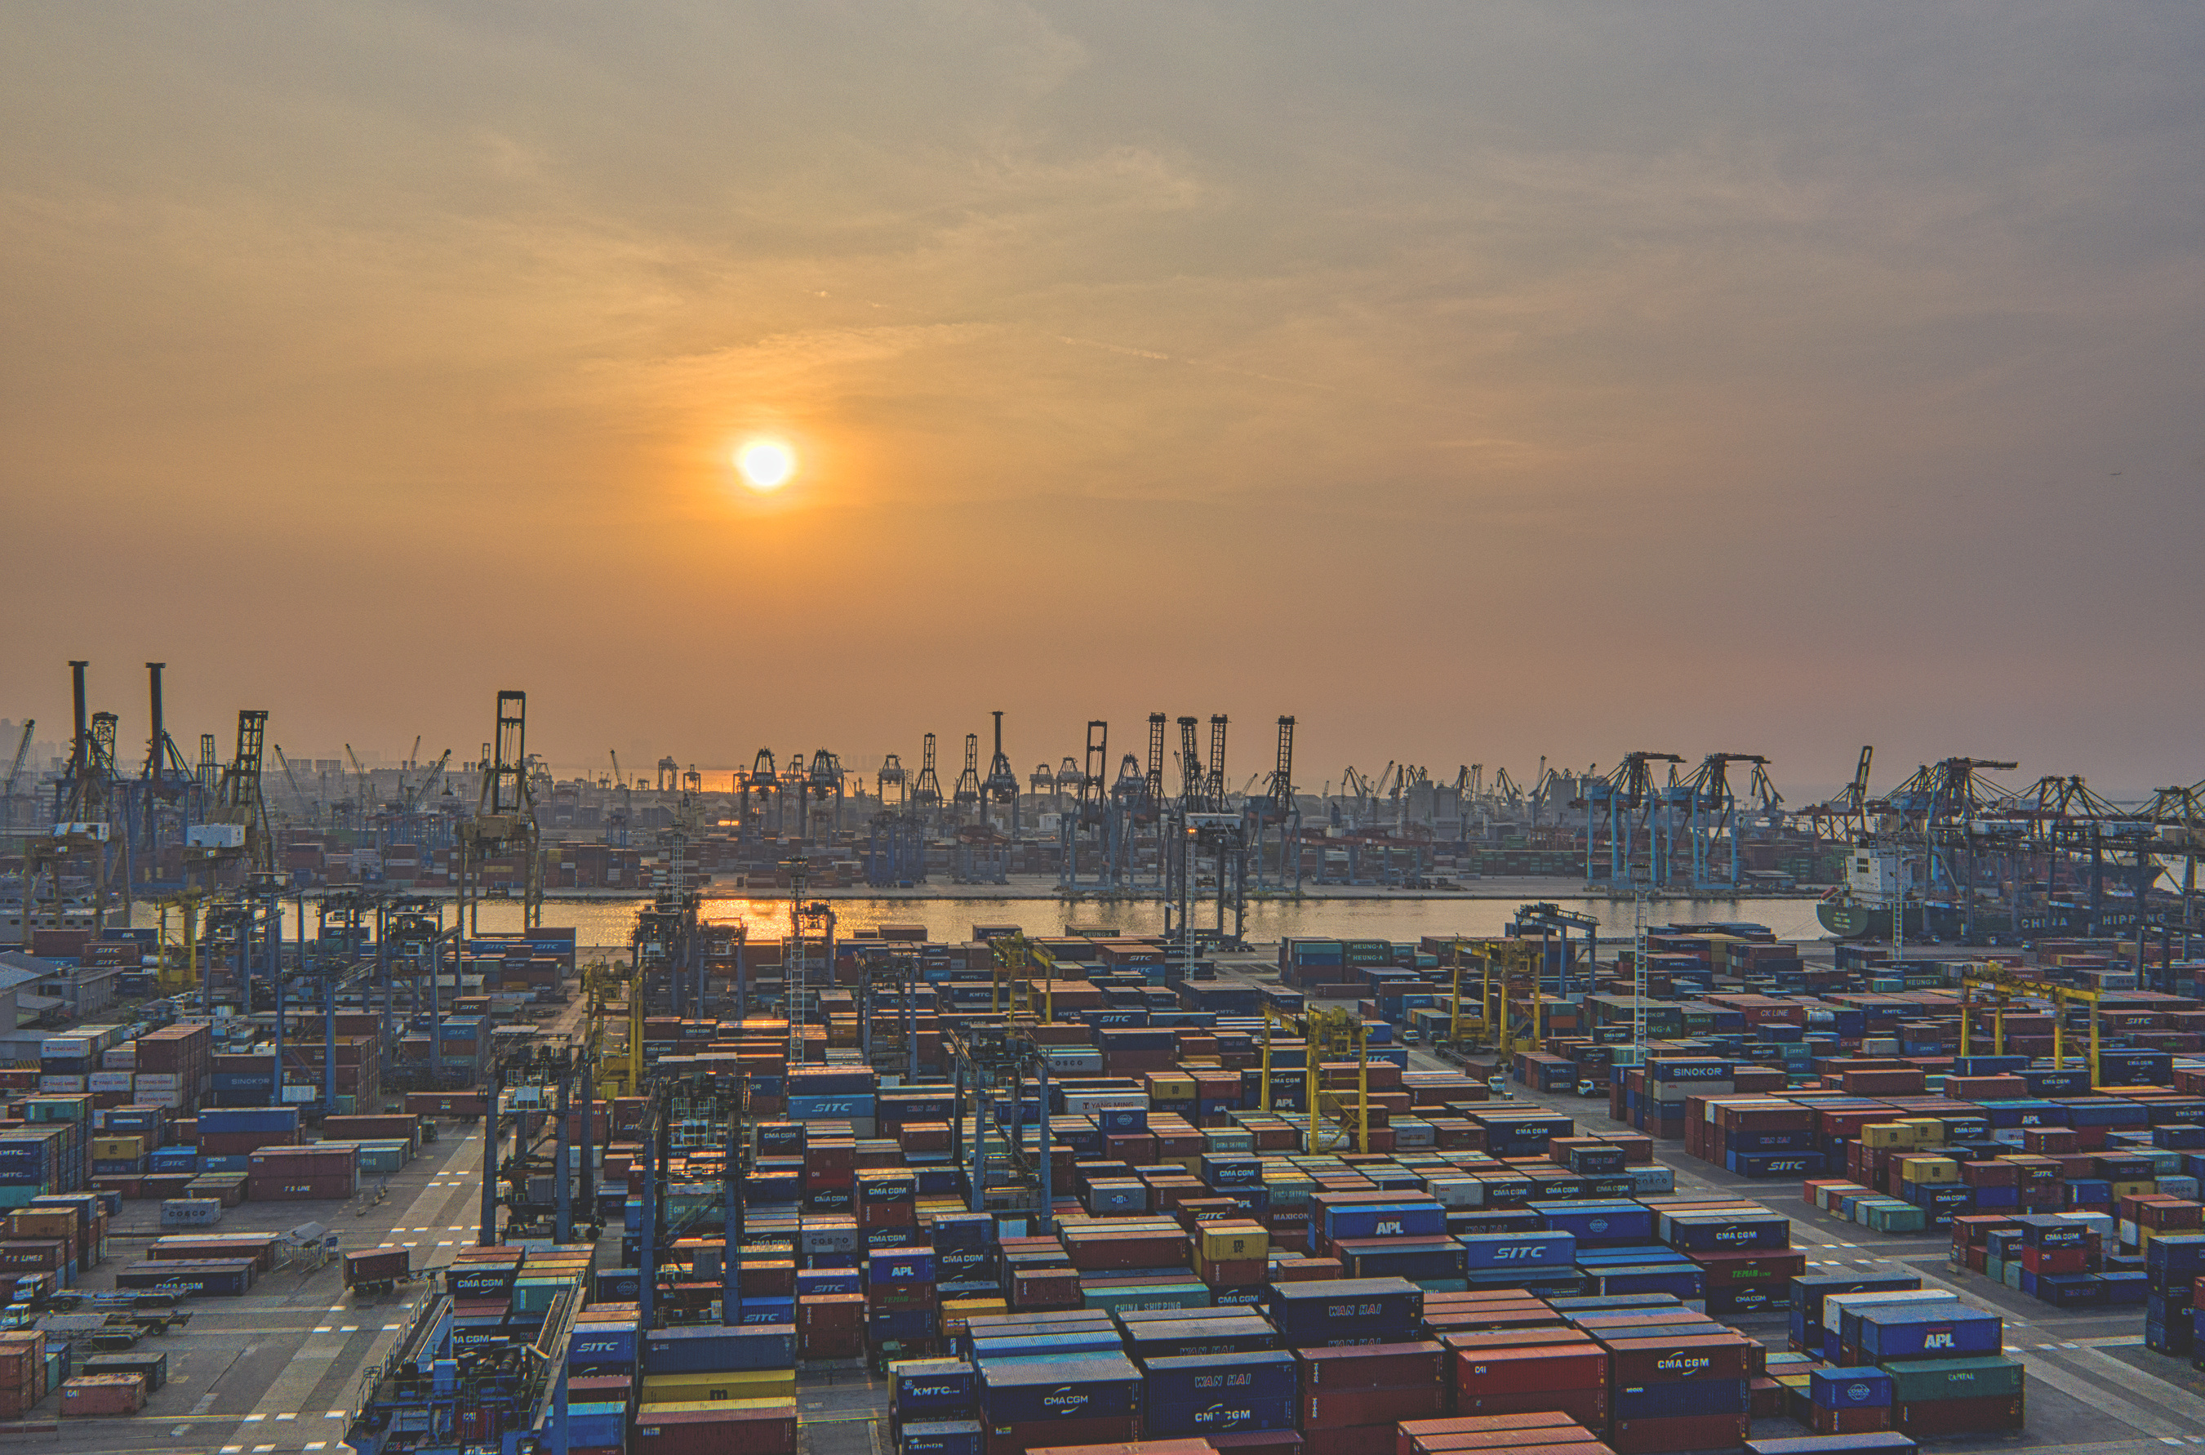
NEWLINK LOGISTICS
ON TIME, EVERY TIME
WWW.NEWLINKLOGISTICS.CO.UK
INFO@NEWLINKLOGISTICS.CO.UK

Slide 2
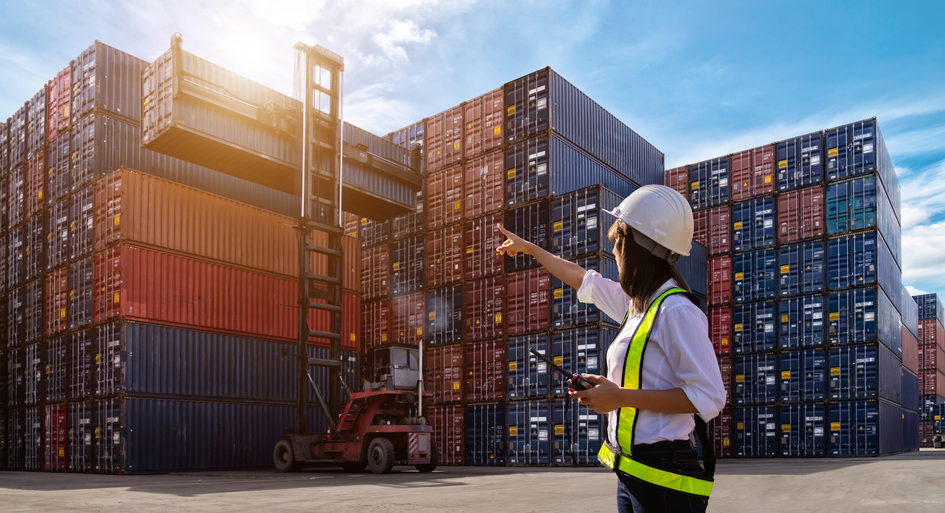
About
Us
We specialize in Domestic, International Courier, Air/Sea Cargo handling, and customs clearance, Our services cover everything from small parcels to large containers, with expertise in handling hazardous and complex shipments.
With headquarter in the UK and network in the UAE, UK, Africa, and China, our extensive network ensures seamless delivery to any destination.
We are dedicated towards setting the standard in logistics industry.

Slide 3




what we
we handle all types of transportation needs, your one stop logistics solution.
Do?
ROAD FREIGHT
AIR CARGO
SEA SHIPPING
RAIL TRANSPORT

Slide 4
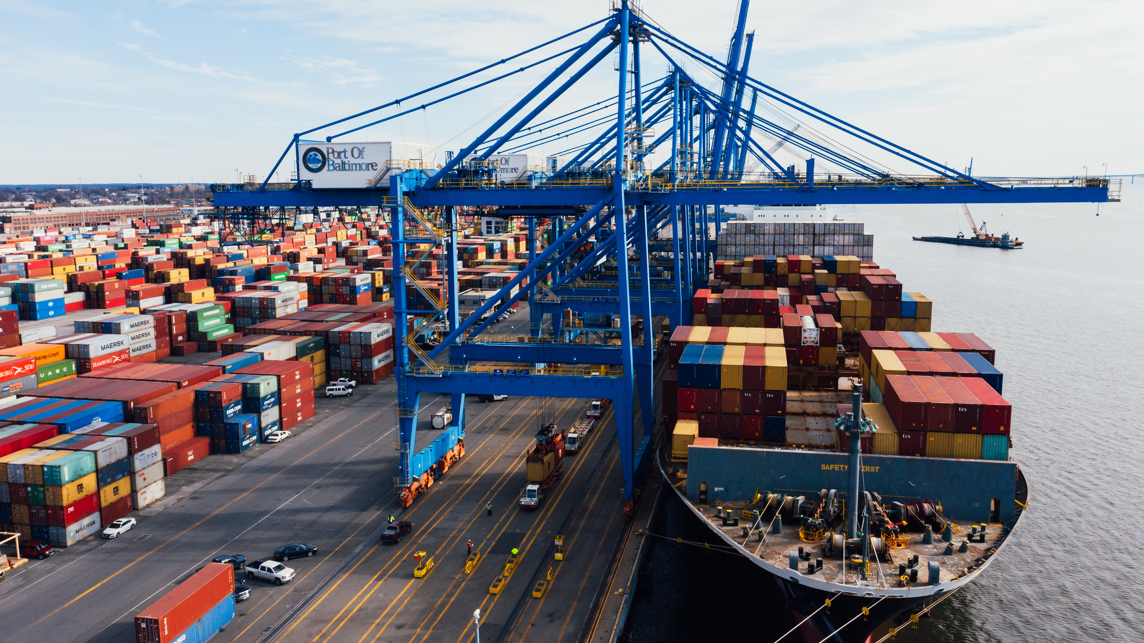
Some
Statistics
We transport more than ;
200 Air Freight shipments
150 Domestic shipments
7 tonnes International couriers
EVERY MONTH
We have 15 company owned vehicles for domestic transport and airport Runs.

Slide 5
THANK YOU
WWW.NEWLINKLOGISTICS.CO.UK
INFO@NEWLINKLOGISTICS.CO.UK

